Slide 2
William Stallings
Computer Organization and Architecture
10th Edition
(Chapter 1-3)
1. Architecture & Organization Definitions
2. Computer Function
  Instruction Fetch and Execute
  Interrupts
  I/O Functions
3. Bus Interconnection

Slide 3
Computer Architecture’s Changing Definition
°1950s to 1960s: Computer Architecture Course: Computer Arithmetic
°1970s to mid 1980s: Computer Architecture Course: Instruction Set Design, especially ISA (Instruction Set Architecture) appropriate for compilers
°1990s: Computer Architecture Course: Design of CPU, memory system, I/O system, Multiprocessors, Networks
°2000s: Multi-core design, on-chip networking, parallel programming paradigms, power reduction, ARM (Advanced RISC Machine) Technology
°2010s: Computer Architecture Course: Self adapting systems? Self organizing structures? DNA Systems/Quantum Computing?
Notes:
Quantum Computing: A multidisciplinary field comprising aspects of computer science, physics, and mathematics that utilizes quantum mechanics to solve complex problems faster than on classical computers.

Slide 4
Architecture & Organization
Computer Architecture refers to those attributes of a system visible to the programmer
  Instruction set, number of bits used for data representation, I/O mechanisms, techniques for addressing memory.
Computer Organization refers to how features are implemented
  Control signals, interfaces b/w computer and peripherals, memory technology used.
  e.g. -It is an architectural design issue whether a computer will have a multiply instruction
  and -It is an organizational issue whether that instruction will be implemented by a special multiply unit or by a mechanism that makes repeated use of the add unit of the system
  Ins. Set - complete collection of instructions that are understood by a CPU
Notes:
The complete collection of instructions that are understood by a CPU - Machine Code, Binary,
Usually represented by assembly codes

Slide 5
Computer Architecture (1)
Definition?
“The design of integrated system which provides a useful tool to the programmer.” (Baer)
“The study of the structure, behaviour, and design of computers.” (Hayes)
“The design of the system specification at a general or subsystem level.” (Abd-Alla)
“The art of designing a machine that will be a pleasure to work with.” (Foster)

Slide 6
Architecture & Organization- Family Concept
Many computer manufacturers offer a family of computer models, all with same architecture but with differences in organization, i.e.
All Intel x86 family share the same basic architecture
The IBM System/370 family share the same basic architecture
Organization differs between different versions
These newer versions retained the same architecture so that customer’s software investment was protected

Slide 7
Structure & Function
Structure is the way in which components relate to each other
Function is the operation of individual components as part of the structure

Slide 8
Computer Functions
All computer functions are:
  Data processing
  Data storage
  Data movement
  Control

Slide 9

A Functional view of the Computer
The computer system must be able to process data, store data and move data b/w itself and the outside world.
A control unit manages the computer’s resources and performance of its functional parts in response to some instructions.
This figure depicts the four possible types of operations.

Slide 10

Operations (1) Data movement
The number of possible operations that can be performed …
(1)
The computer can function as a data movement device, simply transferring data from one peripheral or communication line to another.
  e.g. keyboard to screen

Slide 11
Operations (2) Storage
(2)
The computer can function as a data storage device, with data transferred from the external environment to computer storage for read/write purpose.
  e.g. Internet download to disk

Slide 12
Operation (3) Processing from/to storage
(3)
This diagram show operations involving data processing, on the storage data.
  e.g. updating bank statement

Slide 13
Operation (4)
Processing from storage to I/O
(4)
This diagram show operations involving data processing, on data route b/w storage and the external environment.
  e.g. printing a bank statement

Slide 14
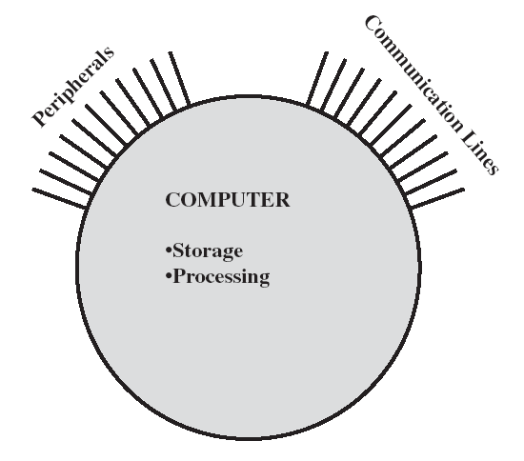
Computer Structure - Top Level
There are four main structural components:
Central Processing Unit (CPU): Controls the operation of the computer and performs its data processing functions; often simply referred to as PROCESSOR
Main Memory: Stores data
I/O: Moves data b/w the computer and its external environment
System Interconnection: Some mechanism that provides for communication among CPU, main memory, and I/O.

Slide 15
Computer Structure - Top Level
Peripherals
Computer
Central
Processing
Unit
Main
Memory
Computer
Systems
Interconnection
Input
Output
Communication
lines

Slide 16
Structure - The CPU
Control Unit: Controls the operations of the CPU and hence the computer
ALU: Performs the computer’s data processing functions
Registers: Provides storage internal to the CPU
CPU
Computer
Arithmetic
and
Login Unit
I/O
Registers
System
Bus
CPU
Internal CPU
Interconnection
Memory
Control
Unit
CPU Interconnection: Some
mechanism that provides for communication
among the control unit, ALU, and registers

Slide 17
Structure - The Control Unit
Control Unit
CPU
ALU
Sequencing
Login
Internal
Bus
Control
Unit
Control Unit
Registers and
Decoders
Registers
Control
Memory

Slide 18
Program Concept
Hardwired Program- process of connecting various components in desired conf. as a form of programming, the resulting ‘program’ is in form of hardware, is called a hardwired program- systems are inflexible. The system accepts data and produces results.
General purpose hardware- system accepts data and control signals and produces results (instead of re-wiring hardware for each new program, supply a new set of
control signals), this new method of
programming, a sequence of codes or
instruction is called software.
What is a program?
A sequence of steps
For each step, an arithmetic or
logical operation is done
For each operation, a different set of
control signals is needed
Sequence of arithmetic and logic functions
Data
Results
(a) Programming in hardware
Instruction interpreter
Instruction codes
Control signals
Sequence of arithmetic and logic functions
Data
Results
(b) Programming in software

Slide 19
Levels of Representation
High Level Language Program
temp = v[k];
v[k] = v[k+1];
v[k+1] = temp;
Compiler
mov ax, bx
add bx, cx
int al, 21
sw $15, 4($2)
Assembly Language Program
Assembler
0000 1001 1100 0110 1010 1111 0101 1000
1010 1111 0101 1000 0000 1001 1100 0110
1100 0110 1010 1111 0101 1000 0000 1001
0101 1000 0000 1001 1100 0110 1010 1111
Machine Language Program
Machine Interpretation
Control Signal Specification
ALUOP[0:3] <= InstReg[9:11] & MASK
°
°

Slide 20
Computer Components
The Control Unit and the Arithmetic and Logic Unit constitute the
  Central Processing Unit
Data and instructions need to get into the system and results out
  Input/output
Temporary storage of code and results, is needed
  Main memory

Slide 21
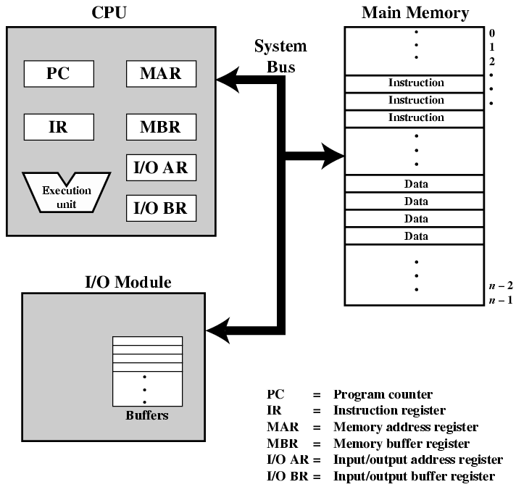
Computer Components:
Top Level View

Slide 22

Computer Function- Instruction Cycle
basic function is execution of a program, which consists of a set of instructions stored in memory
each instruction processing (Inst. cycle) consists of two steps:
  1. Fetch Instruction (Fetch Cycle)
  - from memory using PC reg. that holds address of inst. to be
  fetched next inc PC after each inst. fetch, for in sequence
  execution of inst., fetched inst. loaded into IR reg.,
  2. Execute this Instruction (Execute Cycle)
  - involve several operations, depends on nature of instructions
Machine is turned off, error occurs, etc
Instruction Cycle

Slide 23
1. Fetch Cycle
At beginning, Processor fetches instruction from memory location pointed to by PC
Program Counter (PC) holds address of next instruction to fetch
Increment PC, so that it will fetch next instruction in sequence
Instruction loaded into Instruction Register (IR)
Processor interprets instruction and performs required actions (that fall-into 4 categories)

Slide 24
2. Execute Cycle
The processor interprets inst. & performs required actions, that fall into four categories:
Processor-memory
  Data transfer between CPU and main memory
Processor I/O
  Data transfer between CPU and I/O module
Data processing
  Some arithmetic or logical operation on data
Control
  Alteration of sequence of operations
  e.g. jump, i.e. fetch an inst from location 49, which specifies that next inst. be from 82, by setting PC to 82, so next inst is from 82 rather than 50 location

Slide 25
Execution Cycle- An Example
After fetching Inst.
Obtain instruction from program storage
Instruction
Decode
Determine required actions and instruction size
e.g. to add two no.
X = Y + Z;
Operand
Fetch
Locate and obtain operand data
Execute
Compute result value or status
Result
Store
Deposit results in storage for later use
Next
Instruction
Determine successor instruction;

Slide 26
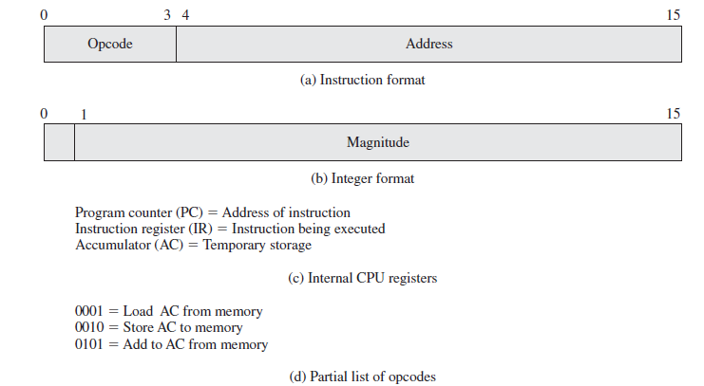
Example of Program Execution
The program fragment shown adds the contents of the memory word at address 940 to the contents of the memory word at address 941 and stores the result in the latter location:

Slide 27
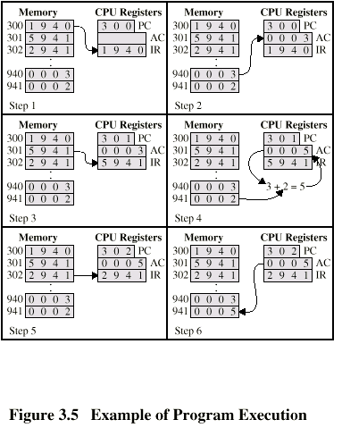
Example of Program Execution
Instruction 1
Instruction 2
Instruction 3
3 Fetch Cycles
3 Execute Cycles

Slide 28
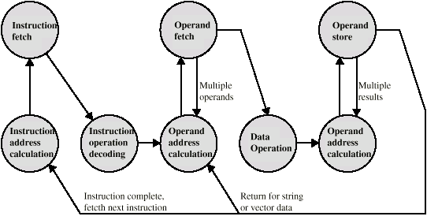
Instruction Cycle - State Diagram

Slide 29
Interrupts
Mechanism by which other modules (e.g. I/O) may interrupt normal sequence of processing
-provided a way to improve processing efficiency e.g. most external devices are much slower than processor, causes a very wasteful use of resources (after each write op, processor must pause and remain idle until printer catches up)
Some common classes of interrupts are:
Program- that occurs as a result of an instruction execution
  e.g. arithmetic overflow, division by zero, out of bound memory,
Timer- this allows OS to perform certain functions on a regular basis
  Generated by internal processor timer
  Used in pre-emptive multi-tasking
I/O- to signal normal completion of an op or variety of error condition
  from I/O controller
Hardware failure- caused by a failure
  e.g. a power failure, memory parity error

Slide 30
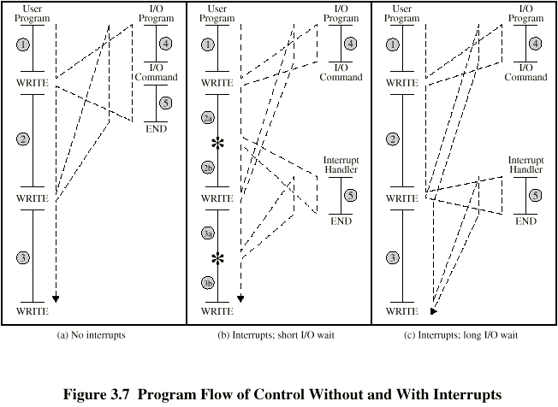
Program Flow Control
(a) In User Program Code segments 1, 2, 3 refer to sequences of instructions that don’t involve I/O. The WRITE calls to an I/O program that is a system utility and that will perform actual I/O operation.
I/O program consists of three sections:
sequence of instructions, labeled 4, may include copying data to be output into a special buffer and preparing parameters for a device command
actual I/O command, (I/O program must wait for I/O device to perform requested function)
a sequences of instructions, labeled 5, to complete the operation, to indicate the success or failure of the operation
Notes:
I/O program consists of three sections:
Labeled 4, may include copying data to be output into a special buffer and preparing parameters for a device command (processor do this)
actual I/O command, (I/O program must wait for I/O device to perform requested function) (Printer is doing this & processor is Idle)
a sequences of instructions, labeled 5, to complete the operation.. (required processor to do this)

Slide 31
Program Flow Control
With interrupts
processor can be engaged in executing other instructions while an I/O operation is in progress
user program reaches a point at which it makes a system call in the form of a WRITE call
after a few I/O (code & comand) instructions have been executed, control returns to the user program, meanwhile external device is busy accepting data from computer memory and printing it.
this I/O operation is conducted concurrently with execution of inst. in user program
to accept more data from processor, I/O module sends an interrupt request signal to processor, the processor responds by suspending operation of current user program

Slide 32
Interrupt Cycle
Added to instruction cycle
Processor checks for interrupt
  Indicated by an interrupt signal
If no interrupt, fetch next instruction
If interrupt pending:
  Suspend execution of current program
  Save context
  Set PC to start address of interrupt handler routine
  Process interrupt
  Restore context and continue interrupted program

Slide 33

Transfer of Control via Interrupts

Slide 34

Instruction Cycle with Interrupts

Slide 35
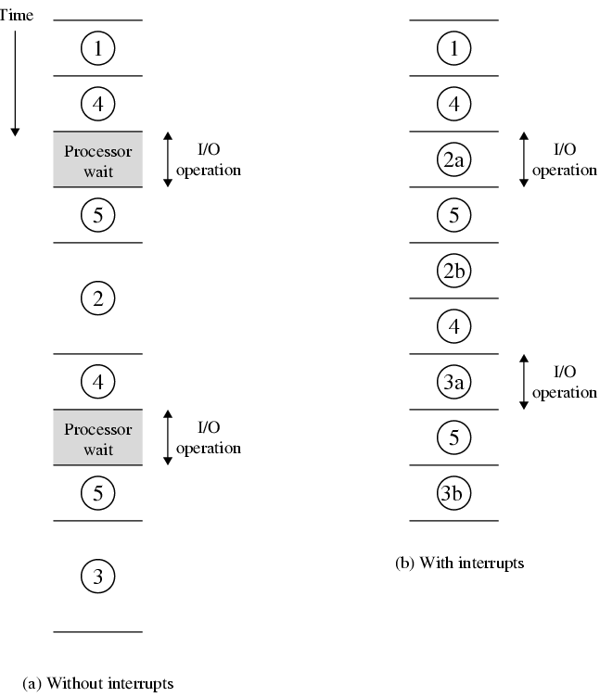
Program Timing
Short I/O Wait

Slide 36
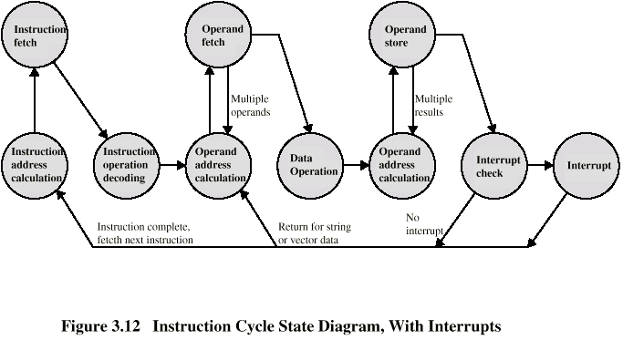
Instruction Cycle (with Interrupts) - State Diagram

Slide 37
Multiple Interrupts
Disable interrupts
  Processor will ignore further interrupts whilst processing one interrupt
  Interrupts remain pending and are checked after first interrupt has been processed
  Interrupts handled in sequence as they occur
Define priorities
  Low priority interrupts can be interrupted by higher priority interrupts
  When higher priority interrupt has been processed, processor returns to previous interrupt

Slide 38

Multiple Interrupts - Sequential

Slide 39
Multiple Interrupts – Nested

Slide 40

Time Sequence of Multiple Interrupts

Slide 41
Interconnection Structures
Collection of paths connecting various modules is called interconnection structure
As computer consists of a set of components or modules of three basic types i.e.,
  Processor (CPU)
  Memory
  Input/Output

Slide 42

Computer Modules input and output for each module type
1) Memory module:
-consists of N words of equal length
-each word is assigned a unique numerical address (0, 1, ….N-1)
-a word of data can be read from or written into memory
-nature of op is indicated by read, write control signals, location is specified by an address
2) I/O module:
-similar to memory module, two op read and write
-I/O module may control more than one external device, each interface is called port with unique address
3) Processor module:
-reads in inst and data, writes out data after processing, uses control signals to control overall op of system. It also receives interrupt signals

Slide 43
Memory Connection (module)
Receives and sends data
Receives addresses (of locations)
Receives control signals
  Read
  Write
  Timing

Slide 44
Input/Output Connection (module)
Similar to memory from computer’s viewpoint
Output
  Receive data from computer
  Send data to peripheral
Input
  Receive data from peripheral

Slide 45
Input/Output Connection (module)
Receive control signals from computer
Send control signals to peripherals
  e.g. spin disk
Receive addresses from computer
  e.g. port number to identify peripheral
Send interrupt signals (control)

Slide 46
CPU Connection (processor module)
Reads instruction and data
Writes out data (after processing)
Sends control signals to other units
Receives (& acts on) interrupts

Slide 47
Buses
There are a number of possible interconnection systems
Single and multiple BUS structures are most common
e.g. Control/Address/Data bus (PC)
e.g. Unibus (DEC-PDP), PCI

Slide 48
What is a Bus?
A communication pathway connecting two or more devices
It is a shared transmission medium
Multiple devices connect to bus
Only one device at a time can successfully transmit
e.g. an 8-bit unit of data can be transmitted over eight bus lines
Computer systems contains a number of different buses that provide pathways b/w components at various levels of computer system hierarchy.
System Bus
A bus that connects major computer components (processor, memory, I/O) is called a system bus
Bus Structure
A system bus consists of from about 50 to hundreds of separate lines, each line is assigned a particular meaning or function
Commonly the bus lines can be classified into three functional groups i.e. data lines, address lines and control lines.

Slide 49
Data Bus data lines collectively called data bus
Carries data or Provide a path for moving data b/w system modules
Data bus may consists of from 32 to hundreds of separate lines
no. of lines being referred to as Width of data bus, each line carry 1-bit, so no. of lines determined how many bits can be transferred at a time, i.e. Width is a key determinant of performance
If data bus is 8-bits wide, each inst is 16-bits long, then processor must access memory module twice during each instruction cycle

Slide 50
Address Bus
Identify the source or destination of data on the data bus
e.g. if processor needs to read a word of data from memory, it puts address of desired word on address bus.
Bus width determines maximum memory capacity of system
Address bus are also used to address I/O ports

Slide 51
Control Bus
are used to control the access to and use of data and address lines
Control lines transmit both command and timing info b/w system modules, timing signals indicate validity of data and address info, command signals specify operations to be performed, e.g.
  Memory write signal (causes data on bus to be written into addressed location)
  Memory read signal (causes data from addressed location to be places on bus)
  I/O read/write signal, Transfer ACK
  Bus request (a module needs to gain control of the bus)
  Bus grant (module has been granted control of the bus)
  Interrupt request (indicates that an interrupt is pending)
  Clock signals (used to synchronize operations)
  Reset (initialize all modules)

Slide 52

Bus Interconnection Scheme

Slide 53
What do buses look like?
  Parallel lines on circuit boards
  Ribbon cables
  Strip connectors on mother boards
    e.g. PCI (peripheral component interconnect)
  Sets of wires

Slide 54
Single Bus Problems
Lots of devices on one bus leads to:
  Propagation delays
    Long data paths mean that co-ordination of bus use can adversely affect performance
    Bus may become a bottleneck, If aggregate data transfer demand approaches the capacity of bus
Most systems use multiple buses to overcome these problems

Slide 55

Traditional Bus Arch. (with cache)
I/O transfers to and from main memory across system bus don’t interfere with processor’s activity
An expansion bus interface buffers data transfers b/w system bus and I/O controllers on expansion bus, and allows system to support a wide variety of I/O devices
It is reasonably efficient but begins to break down as higher an higher performance is seen in I/O devices
SCSI = Small computer system interface

Slide 56
High Performance Bus Architecture
It requires only a bridge b/w processor’s bus & high-speed bus
A local bus connects processor to a cache controller, which in turn connected to a system bus that supports memory
Cache controller is integrated into a bridge, or buffering device, that connects to the high speed-bus

Slide 57
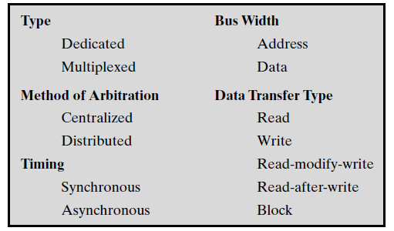
Elements of Bus Design
There are a few basic parameters or design elements that serve to classify and differentiate buses:

Slide 58
Elements of Bus Design
1) Bus Types
Dedicated (permanently assigned to one function)
  Separate data & address lines
  Potential advantage is high throughput
Multiplexed (using same lines-bus for multiple purpose)
  Address and data information may be transmitted over same set of lines, using
  Address valid or data valid control line
  Advantage - fewer lines, saves space and cost
  Disadvantages
    More complex control circuit is needed within each module
    Ultimate performance, a potential reduction in performance because certain events that share same lines cannot take place in parallel

Slide 59
2) Bus Arbitration
More than one module may need control of the bus
e.g. an I/O module may need to read/write directly to memory, without sending data to processor, because
Only one module may control bus at one time,
So some method of arbitration is needed
Arbitration may be centralised or distributed

Slide 60
Centralised Arbitration
A single hardware device is responsible for allocating time on the bus, i.e.
  Bus Controller
  Arbiter
May be part of processor or separate module

Slide 61
Distributed Arbitration
There is no central controller
Each module may claim the bus
Each module contains access control logic and modules act together to share the bus

Slide 62
3) Timing
A way in which events are coordinated on bus
Synchronous timing or asynchronous timing
Synchronous timing
  Occurrence of Events on bus is determined by a clock
  Bus includes a clock line upon which a clock transmits a regular sequence of 1s and 0s of equal duration,
  A signal 1-0 is called a bus cycle or a time slot
  All other devices on the bus can read clock line
  Usually sync on leading edge i.e. (all events start at beginning of a clock cycle)
  Usually a single cycle for an event

Slide 63
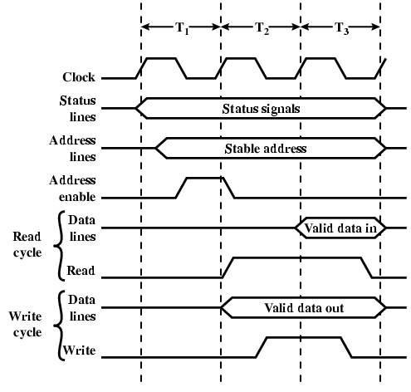
Synchronous Timing Diagram
e.g. processor places a memory address on address lines during first clock cycle, and may assert various status lines (1st cycle)
processor issues an address enable signal (1st cycle)
for read op processor issues a read command at 2nd cycle
a memory module validate address, after a delay of one cycle, places data on data bus
for write op processor puts data on data bus at start of 2nd cycle, and issues write command, then memory module copies data from data bus during 3rd clock cycle

Slide 64
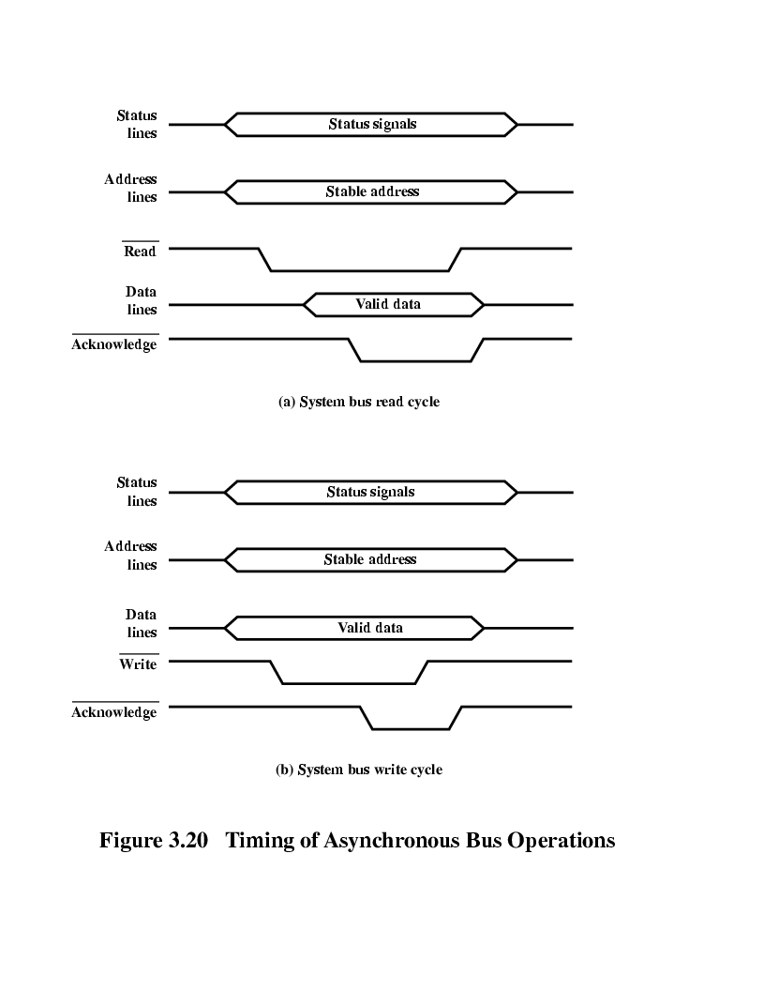
Asynchronous Timing – Read Diagram
Occurrence of one event on bus follows and depends on occurrence of a previous event. e.g. processor places address and status signals on bus, after pausing for these signals to stabilize it issues read command, memory module decodes address & places data on data bus, and then asserts ACK to signal processor that data available. After reading data, processor de-asserts read signal, this cause memory module to drop data and ACK lines, finally processor removes address information

Slide 65
Asynchronous Timing – Write Diagram
- Synch timing is simpler to implement and test, but less flexible than Asynch. Because all devices are tied to fixed clock rate, system cannot take advantage of advances in device performance, but with Asynch a mixer of slow-fast devices, using older-newer tech. can share bus

Slide 66
Bus Width
Data Transfer Type
Bus supports various data transfer types:
Write (non-multiplexed) operation
Read (multiplexed) operation
Read (non-multiplexed) operation
Read-modify-write operation
Read-after-write operation etc.

Slide 67
PCI Bus
Peripheral Component Interconnection is a popular high-bandwidth or peripheral bus
Use of up to 64 data lines at 66 MHZ, for a raw transfer rate of 528 MBytes/s
It is high-speed supports other buses attached to it, as well as designed to meet economically I/O requirements of modern systems
support a variety of microprocessor-based configurations, including both single- and multiple-processor systems
It makes use of synchronous timing and a centralized arbitration scheme

Slide 68
PCI Bus Lines Structure (required)
PCI (32 or 64-bit bus), contains several signal lines and are divided into following functional groups:
Systems lines or pins
  Including clock and reset
Address & Data pins
  32 time mux lines for address/data
  Interrupt & validate lines
Interface Control (Control the timing of transactions and provide coordination among initiators and targets)
Arbitration
  Not shared
  Direct connection to PCI bus arbiter
Error lines (report parity and other errors)

Slide 69
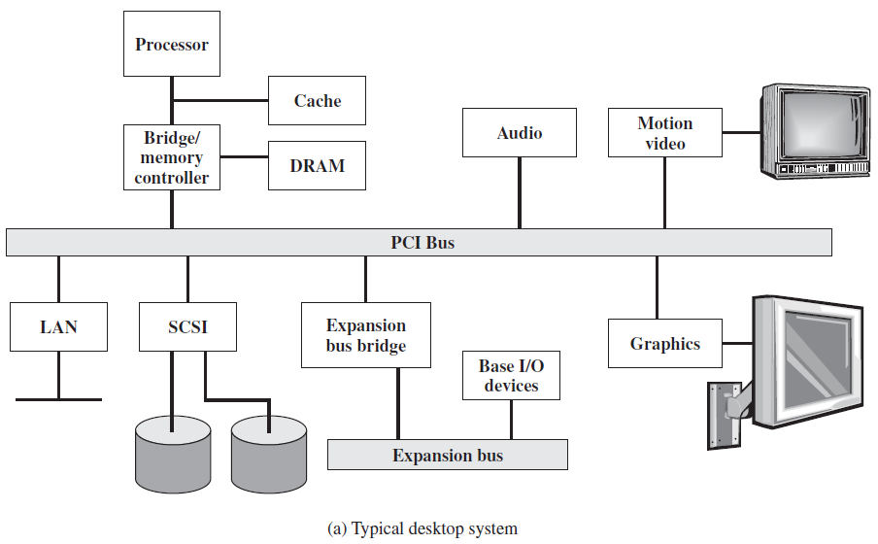
PCI Bus Configuration…

Slide 70
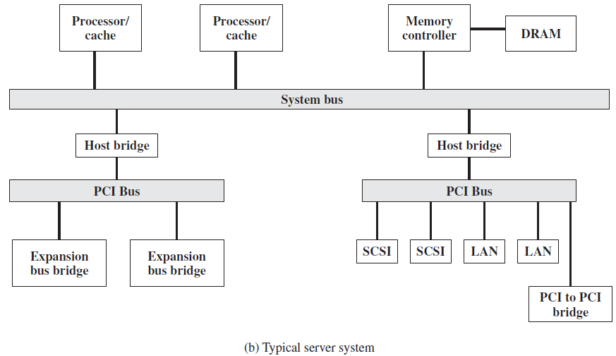
PCI Bus Configuration…

Slide 71
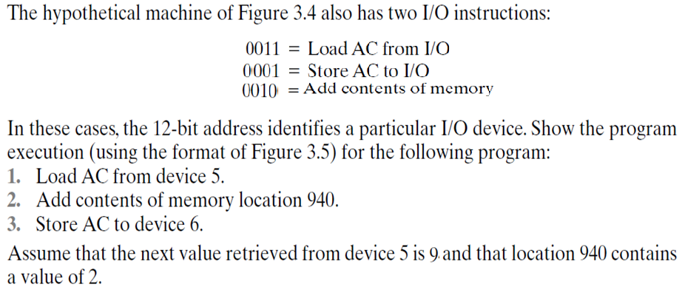


Problem 1:

Slide 72
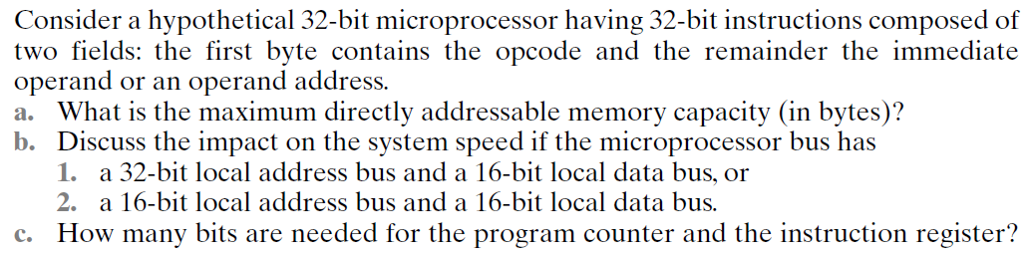
Problem 2

Slide 73
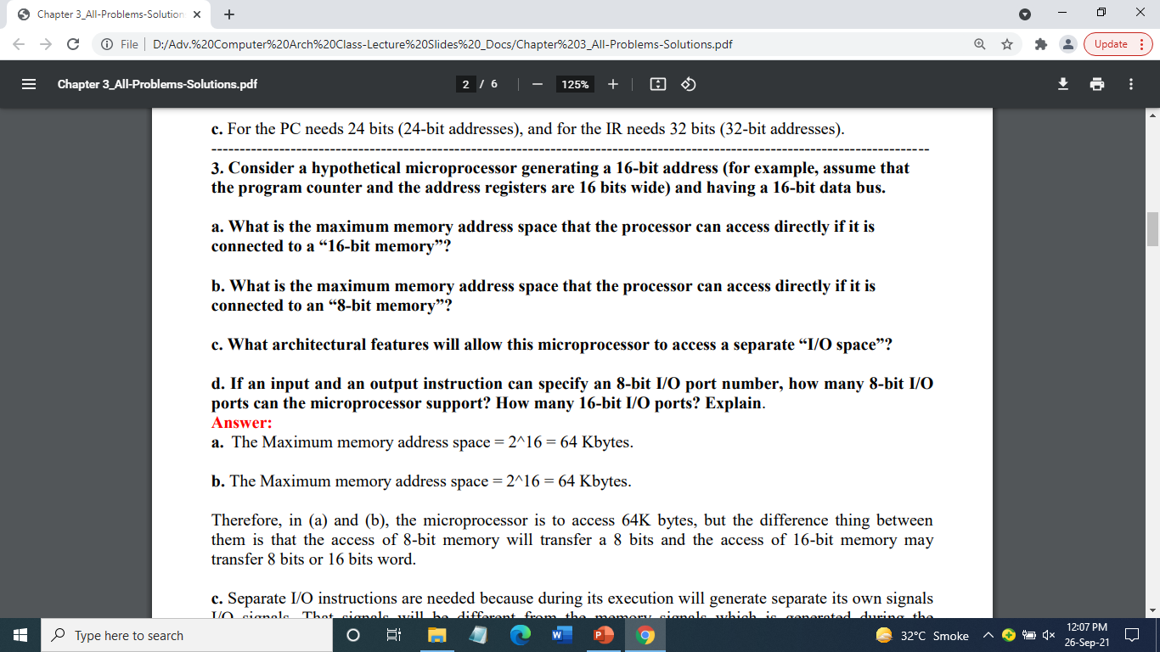
Problem 3
Notes:
C: one more output pin will be needed to carry I/O signals

Slide 74
Foreground Reading
Stallings, chapter 3 (all of it)
www.pcguide.com/ref/mbsys/buses/
In fact, read the whole site!
www.pcguide.com/

